Slide 1


CMR TECHNICAL CAMPUS
BLOCKCHAIN BASED PORTAL FOR FARMERS
UGC AUTONOMOUS
DEPARTMENT OF
COMPUTER SCIENCE AND ENGINEERING
Mini project of:
Padigela Sahithi Reddy 207r1a0547
Kirthi Santoshi Laxmi 207r1a0527
Under the guidance of:
DR. K. Srujan Raju
Professor -CSE Department

Slide 2
CONTENTS
Abstract
Existing System
Drawbacks
Proposed system
Advantages of proposed system
Hardware and Software Requirements
Novelty
Architecture
System Modules
UML Diagrams
Sample Code
Results
Conclusion
Future Scope
References
Github Link

Slide 3
ABSTRACT
Farmers, as well as agriculture, are the foundation of life.
A range of research shows that with the various enhancements in the field of ICT(Information and Communications Technology), the farmers are unable to take its advantage and fail to get the proper sale value for their crops.
So introducing a technology such as blockchain is an urgent need. Where the problems faced by farmers are solved. This Blockchain system benefits the farmers and individuals by preserving the contract of trade.
It implements features like peer to peer transaction, avoiding middle men in the trades, poor collaborations and coordinations.
Leading the generations towards a decentralised network and entrusting them with the services provided, is the main objective of our study and this project.

Slide 4
EXISTING SYSTEM
According to system proposed by Manav et al. which is an Android based mobile application that takes care of updating the farmers, regarding agricultural products. However, the system is good in providing the instant update to the farmer but the version is only in the English language, which is the limitation of the system.
Most of the time Farmers fail to get proper price for their crops, due to less availability of proper marketing resources and platform.
Disputes in supply chain management.

Slide 5
DISADVANTAGES OF EXISTING SYSTEM
Transaction depends on third party.
Intermediate disputes due to middle men.
Data stored in local servers it means data may be not secure
Tampered Transactions
Centralized System
Low Efficiency
Complex User Interface

Slide 6
PROPOSED SYSTEM
The Proposed Farmer’s portal is a single gateway through which the ecommerce activity of crops can be performed.
It uses decentralised systems which enables secure environment, and can access it from anywhere and at anytime.
Maintains multiple server systems.
Implements peer-to-peer transactions, coordinations and collaborations based on distributed system databases by means of data encryption and time stamping.
Each transaction is verified and added to chain.
The blockchain distributed ledger guarantees the fairness and authenticity of transaction and avoids possibility of transaction being tampered.

Slide 7
ADVANTAGES OF PROPOSED SYSTEM
Faster transactions
Immutable records
Transparency in supply chain
Improved Security
Higher Fair
Removal of middlemen
High accuracy
High efficiency

Slide 8
HARDWARE
REQUIREMENTS
SOFTWARE
REQUIREMENTS
System : i3 or above
RAM : 8GB or above
Hard Disk : 516 GB SSD or above
CPU : 1GHz
Operating system : Windows 8 or above.
Coding Language : Python
Front-end : Html, CSS, Javascript.
Frameworks : Django
Database : SQLite
Security and Integration tools

Slide 9
NOVELTY
Improved speed of transactions
Entrusting users with the services
Transparency in supply chain
Brings decentralisation
Improved user experience and interface
Better and secure future in trade

Slide 10
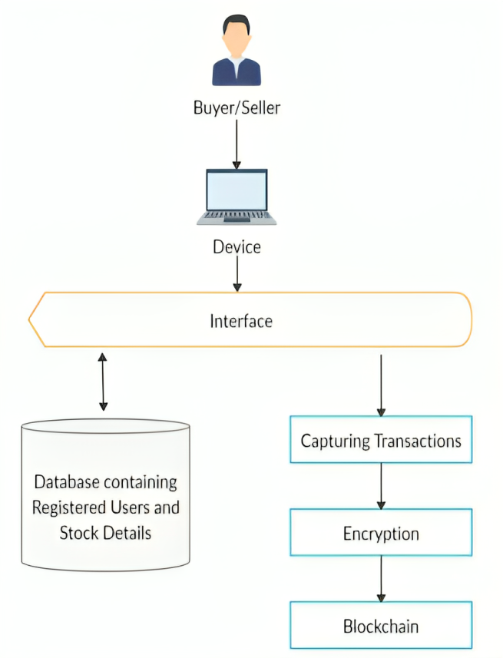
SYSTEM ARCHITECTURE

Slide 11
SYSTEM MODULES
SELLER : The Seller User can register first. The seller can add a new item, update existing items, allot and update the price of the item.
BUYER : The buyer can buy a product and can search for any product according to the requirement and add the product to the cart.
ADMIN : Admin can login with his credentials. Once he login he can activate the sellers and buyers.
BLOCKCHAIN : It makes the portal more secure as the data is immutable,transaparent and accessible to all.

Slide 12
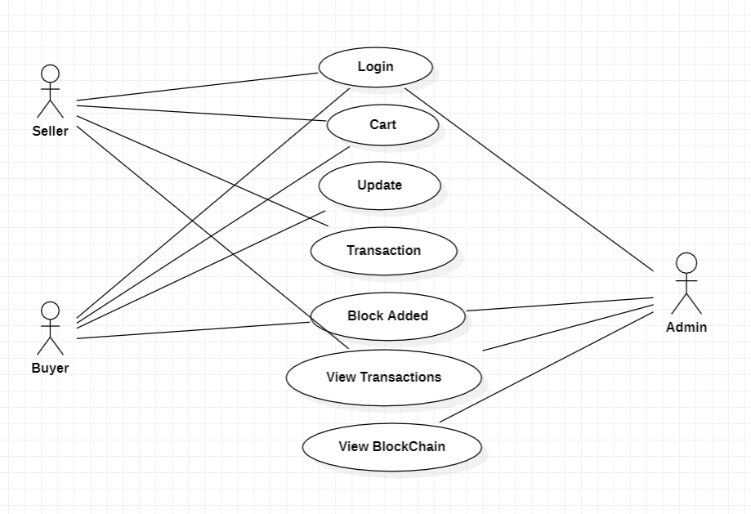
1.USE CASE DIAGRAM
UML DIAGRAMS

Slide 13
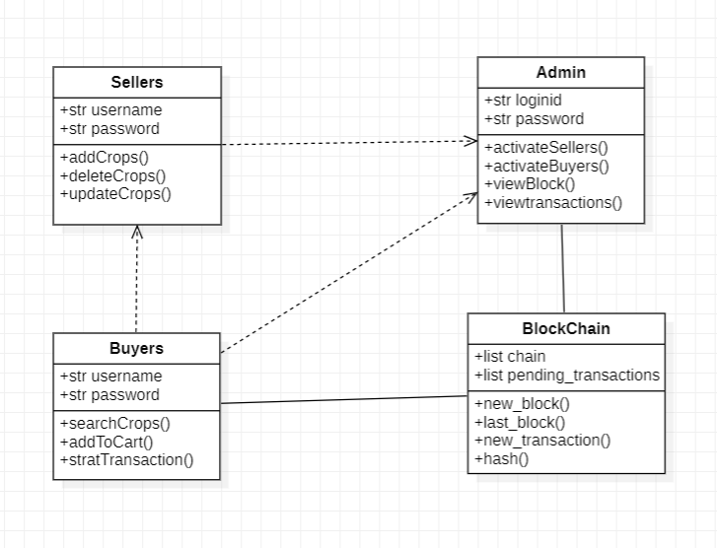
2.CLASS DIAGRAM

Slide 14
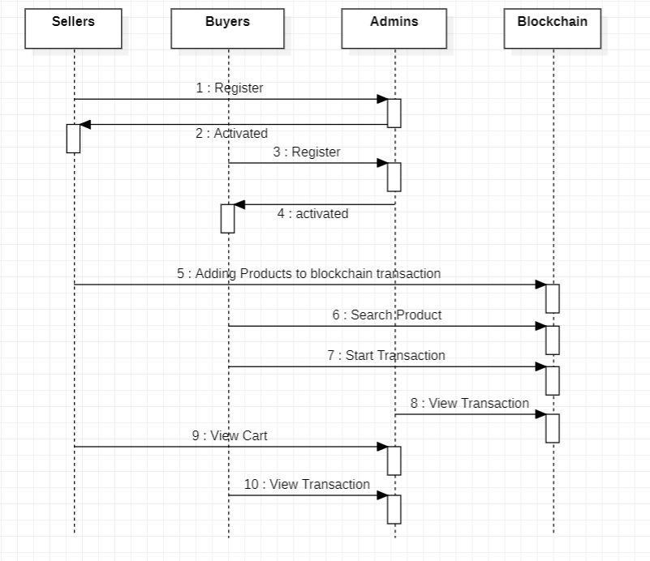
3. SEQUENCE DIAGRAM

Slide 15
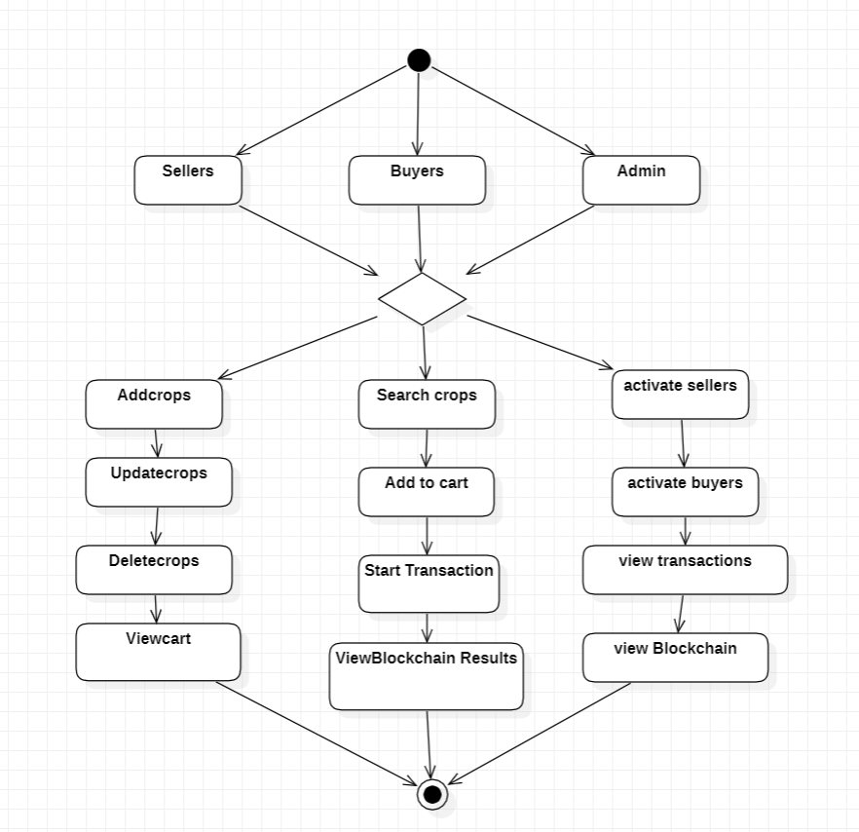
4 ACTIVITY DIAGRAM

Slide 16
SAMPLE CODE
views.py
from django.shortcuts import render
from sellers.forms import SellerUserRegistrationForm
from buyers.forms import BuyerUserRegistrationForm
def index(request):
return render(request,"index.html",{})
def logout(request):
return render(request, 'index.html', {})
def SellerLogin(request):
return render(request, 'SellerLogin.html', {})
def BuyerLogin(request):
return render(request, 'BuyerLogin.html', {})
def AdminLogin(request):
return render(request, 'AdminLogin.html', {})
def SellerRegister(request):
form = SellerUserRegistrationForm()
return render(request, 'SellerUserRegistrations.html', {'form': form})
def BuyerRegister(request):
form = BuyerUserRegistrationForm()
return render(request, 'BuyerUserRegistrations.html', {'form': form})

Slide 17
manage.py
import os
import sys
if __name__ == "__main__":
os.environ.setdefault("DJANGO_SETTINGS_MODULE", "FarmerBlockchain.settings")
try:
from django.core.management import execute_from_command_line
except ImportError as exc:
raise ImportError(
"Couldn't import Django. Are you sure it's installed and "
"available on your PYTHONPATH environment variable? Did you "
"forget to activate a virtual environment?"
) from exc
execute_from_command_line(sys.argv)

Slide 18
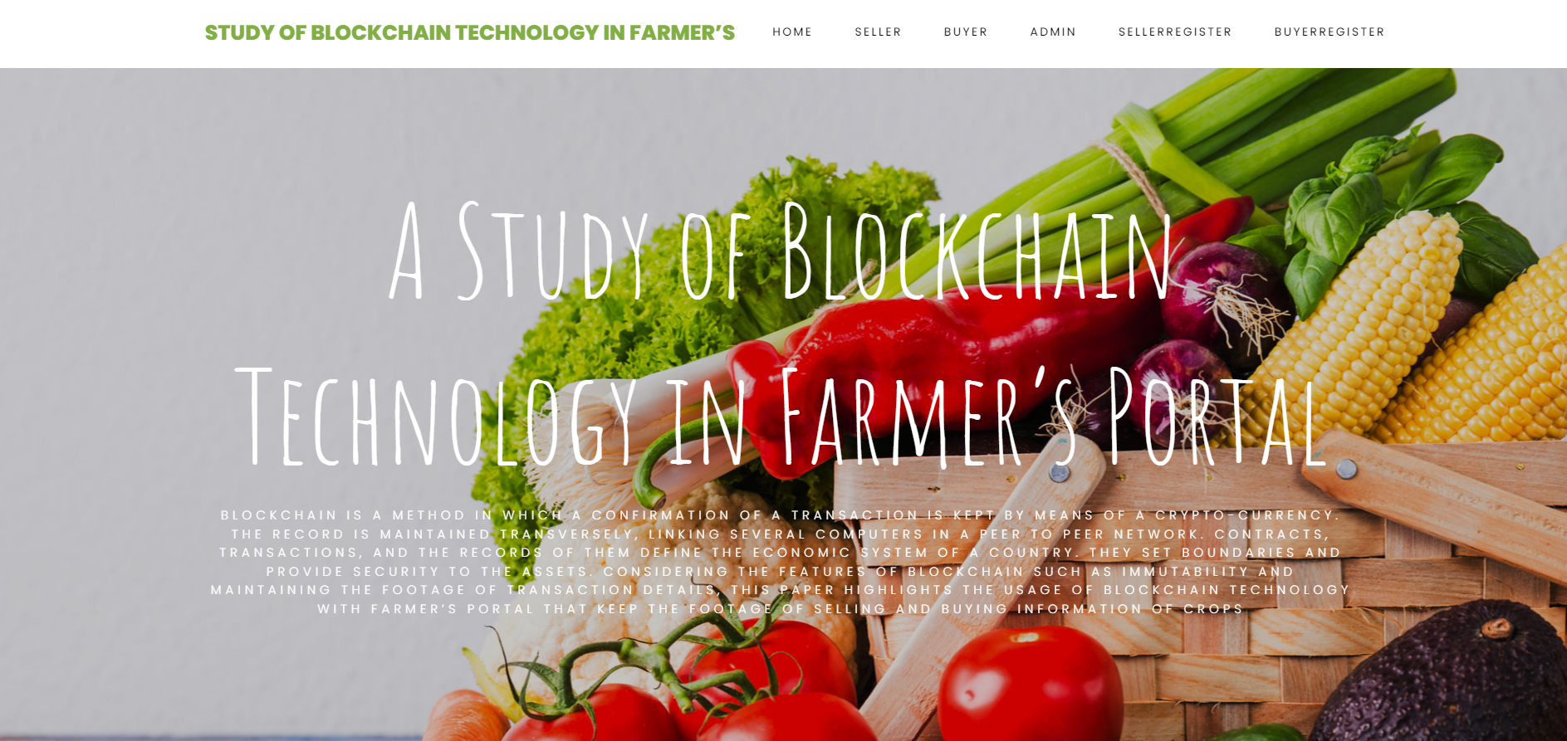
Result
HOME PAGE

Slide 19
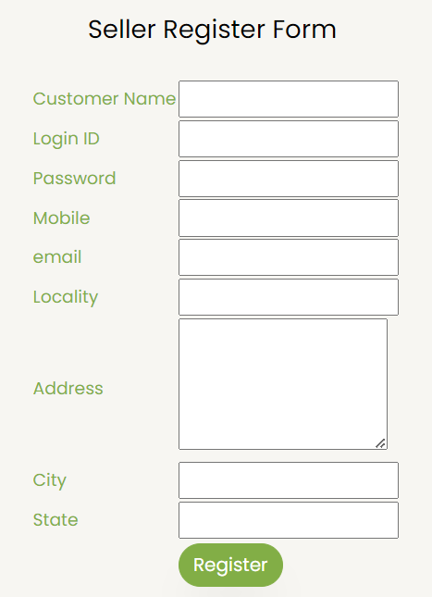
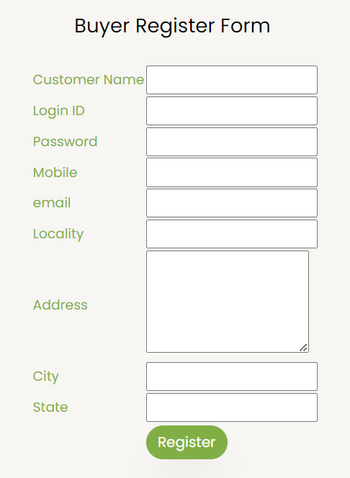

Slide 20
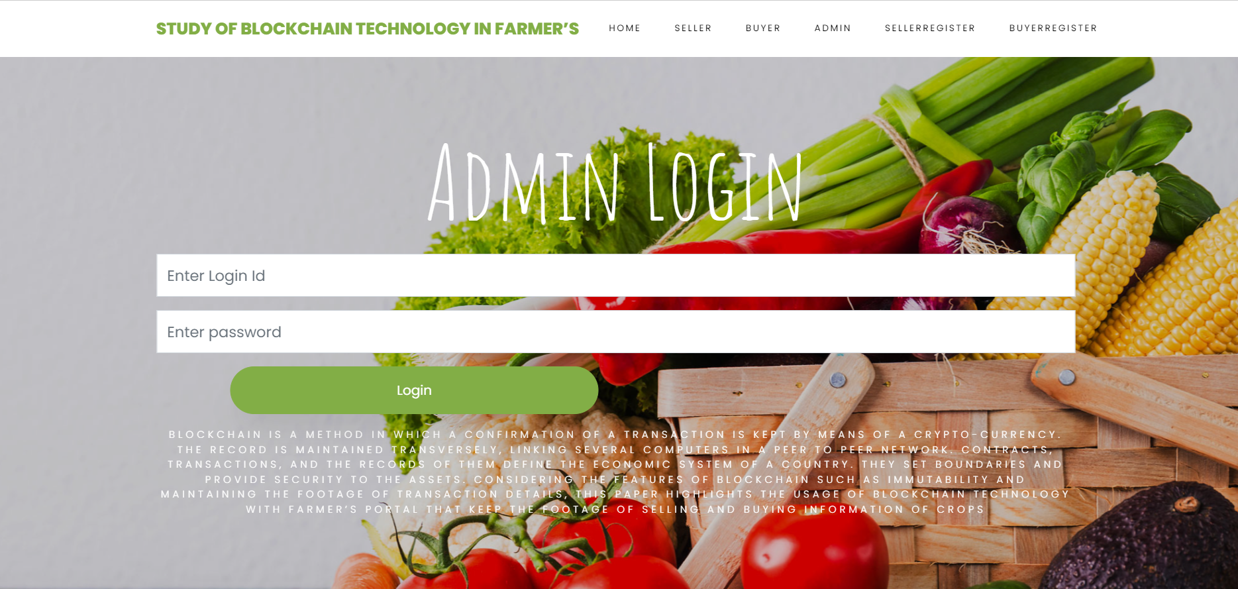
1.ADMIN LOGIN

Slide 21
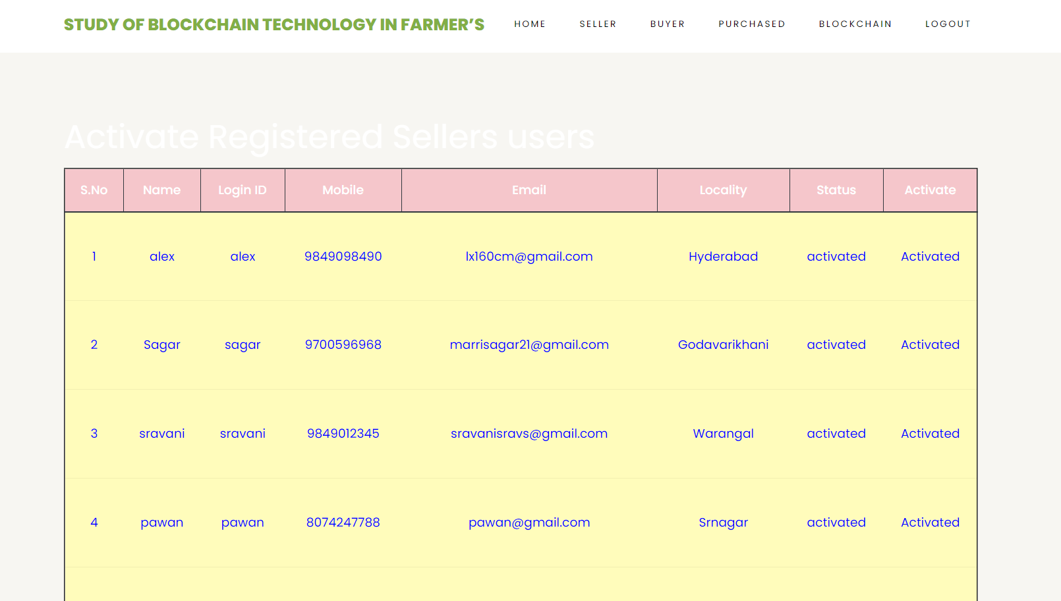
ADMIN ACTIVATE BUYERS

Slide 22
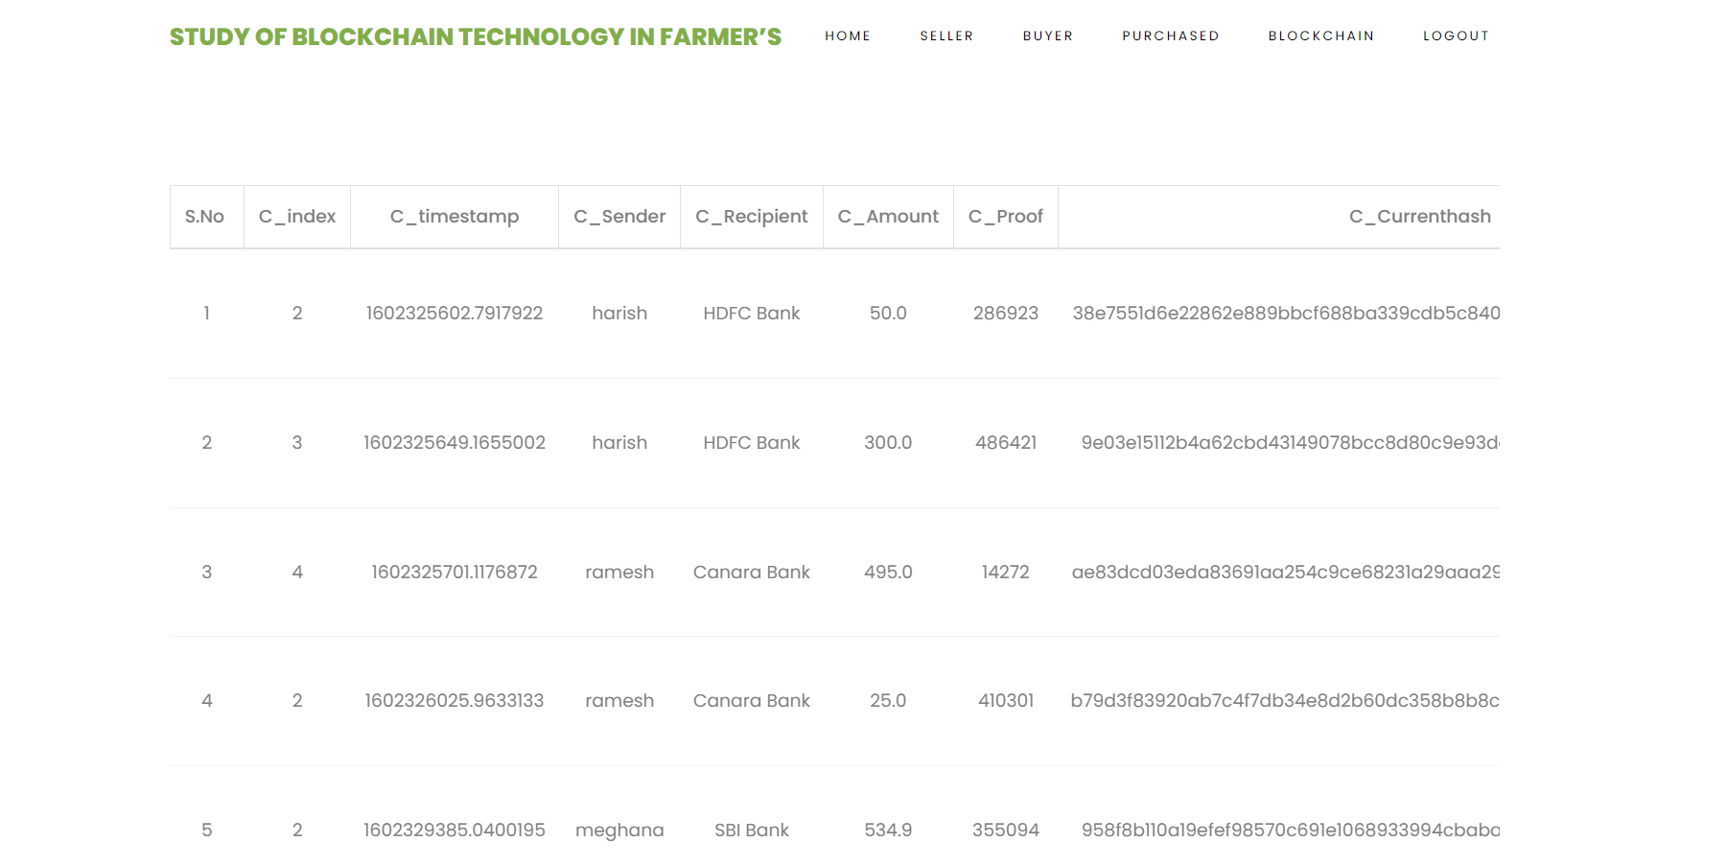
ADMIN VIEW BLOCKCHAIN TRANSACTION

Slide 23
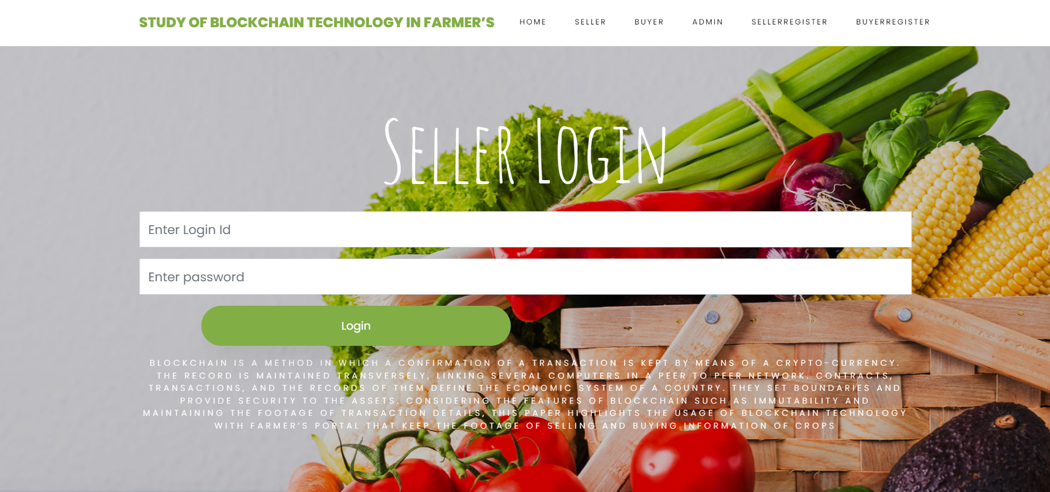
2. SELLER LOGIN

Slide 24
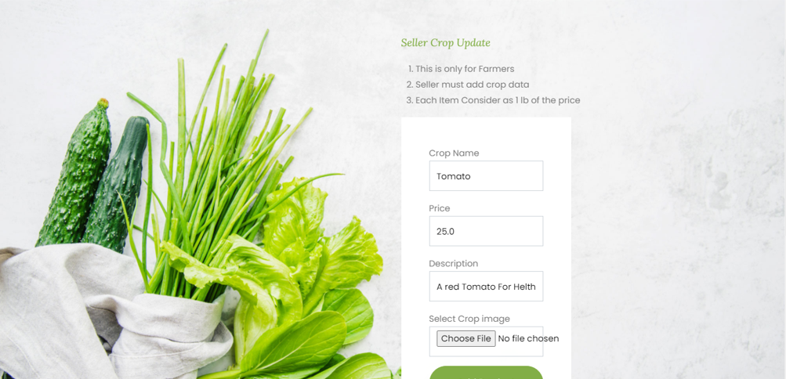
SELLER UPDATING CROPS

Slide 25
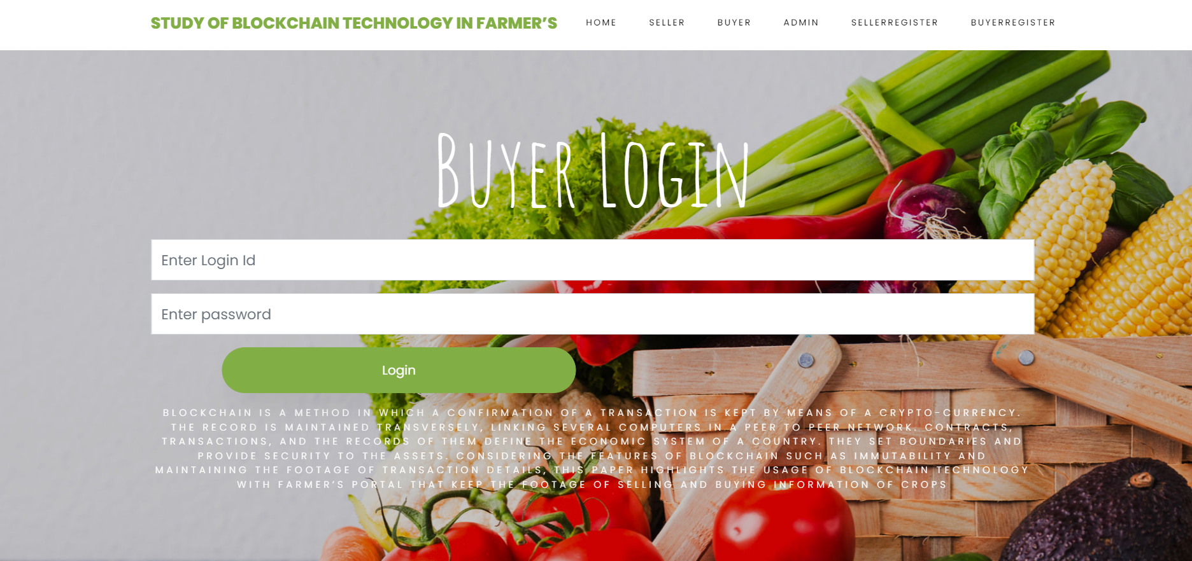
3.BUYER LOGIN

Slide 26
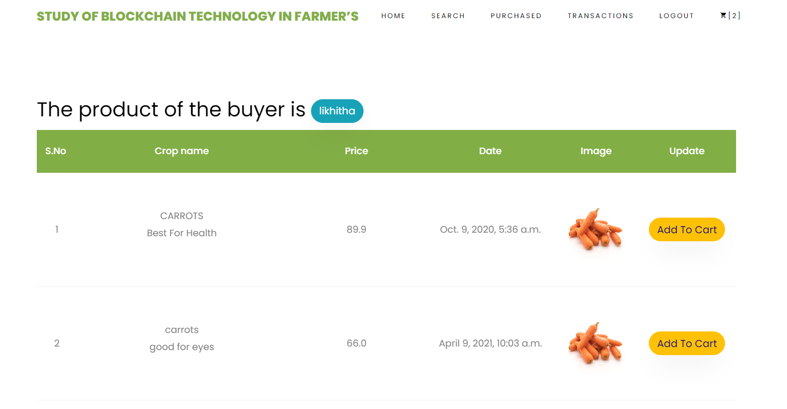
BUYER CART VIEW

Slide 27
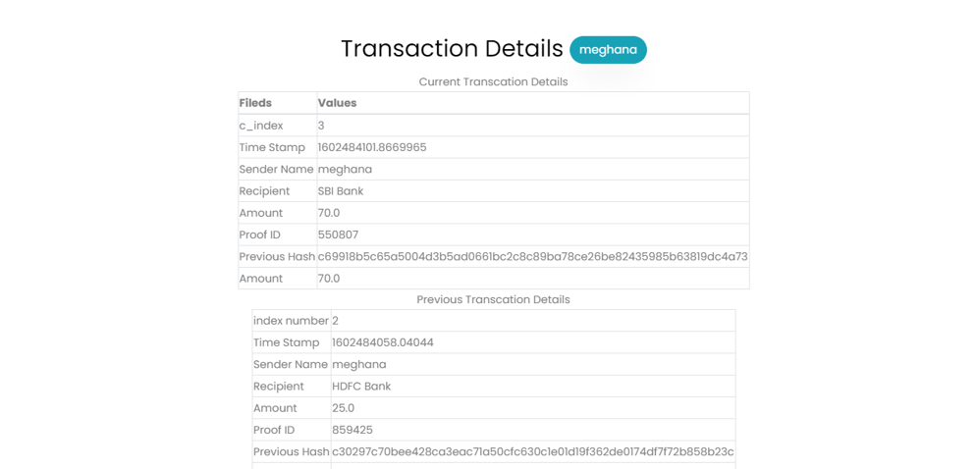
4.BLOCKCHAIN

Slide 28
CONCLUSION
Blockchain Technology in the field of agriculture can bring revolutionary enhancement in the area of maintaining farmers data securely, ensuring the security of transactions, and sale price of crops. In this project the block chain-based portal is involved in dealing with the issue of demand and sale price of crops which in result ensure crop security to farmers as well as to get fair price of the crop. A farmer can register and sell his crops, recording a transaction on a block chain at a point when buyers commit to buy a farmer's crop. This transaction is capable of recording crop details, the price at which it is committed to buying and quantity of crop purchased. This immutable nature of block chain technology will enable the farmers to get a legitimate price of crop and reduce the cost of operation for selling and buying crops when compared to traditional methods.

Slide 29
FUTURE SCOPE
Creating a website or platform to improve farming and crop commerce. By using blockchain technology, they can make this platform more efficient. This involves recording farmer and buyer information on the blockchain, adding more features and services, and offering various benefits to farmers. To ensure the information's accuracy and security, they would use open, secure, and trusted systems, assuming the infrastructure and network connections are also secure.
Chatbot can also be introduced where farmers can solve their queries

Slide 30
REFERENCES OF OUR STUDY
Hileman, Garrick, and Michel Rauchs. "2017 global blockchain benchmarking study." Available at SSRN 3040224 (2017).
Yadav,Vinay Surendra, and A. R. Singh. “A Systematic Literature Review of Blockchain Technology in Agriculture.”
Ghosh, Soumalya, A. B. Garg, Sayan Sarcar, PSV S. Sridhar, Ojasvi Maleyvar, and Raveesh Kapoor. "Krishi-Bharati: an interface for Indian farmer”. In Proceedings of the 2014 IEEE Students' Technology Symposium, pp. 259-263. IEEE, 2014.
Zhu, Xingxiong, and Dong Wang. "Research on Blockchain Application for E-Commerce, Finance and Energy." In IOP Conference Series: Earth and Environmental Science, vol. 252, no. 4, p. 042126. IOP Publishing, 2019.

Slide 31
GITHUB LINK
https://github.com/sahithi-padigela/MINI-PROJECT

Slide 32
T
H
A
N
K
Y
O
U

